Slide 1
Parallel Image Processing Final Project
Real Time Mosaic Processing For
Multiple Videos Display
2021.06.17
(22211236) TaeHyeon Jeong
Notes:
Hello, good afternoon. My name is Taehyeon Jeong and let me start the presentation of Final Project

Slide 2
Contents
Problem
Solution
Experimental Results
Analysis
Conclusion
Notes:
Contents for the presentation is as follows.

Slide 3
Problem
Real Time Mosaic Processing For Multiple videos display
Load the 16 videos using OpenMP
Mosaic the videos with down sampling
Automatically sets the downsampling factor based on device(CPU, GPU) specifications
Change images of various sizes to the same size
Compare the processing time between CPU and GPU
For CPU version
IPP, OpenMP
For GPU version
CUDA
Notes:
I’ll skip detail of project because other people explained the problem well.
In this project, professor said no opencv function in here. Therefore, I don’t use anything except for Mat.
I coded CPU version using IPP and OpenMP, and GPU version using CUDA.

Slide 4
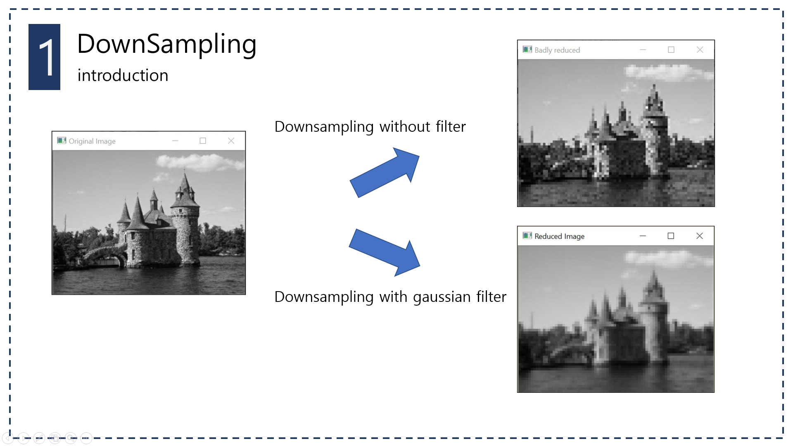
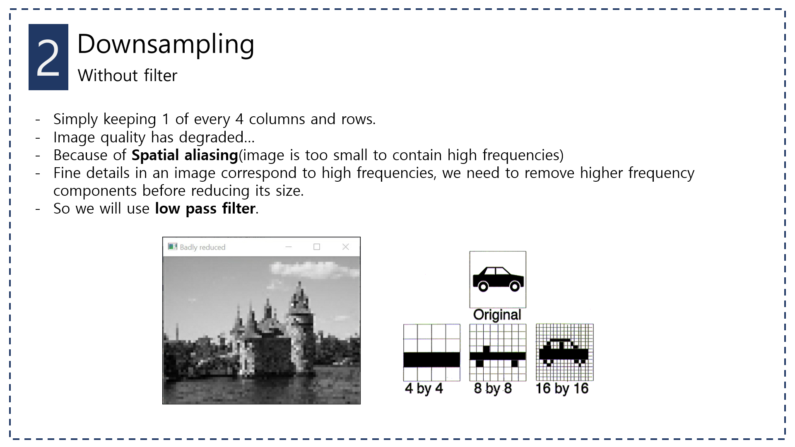

Solution
DownSampling (without filter)
Simply keeping 1 of any columns and rows
Image quality has degraded
Because of Spatial aliasing, image is too small to contain high frequencies
Notes:
First of all, the most basic approach for DownSampling is spatial aliasing. This is a technique to downsample the image by the size ratio of the source image and the target image. It works well, but it is not as smooth as it looks.

Slide 5



Solution
DownSampling (with Gaussian filter)
Before spatial aliasing, proceed with Gaussian filter
High frequency part of spatial aliasing can be solved
Notes:
Therefore, the process of smoothing before spatial aliasing is needed for appropriate result. We can satisfy the process through Gaussian Blur. If you proceed Gaussian as shown in picture, you can get a good result like that.

Slide 6
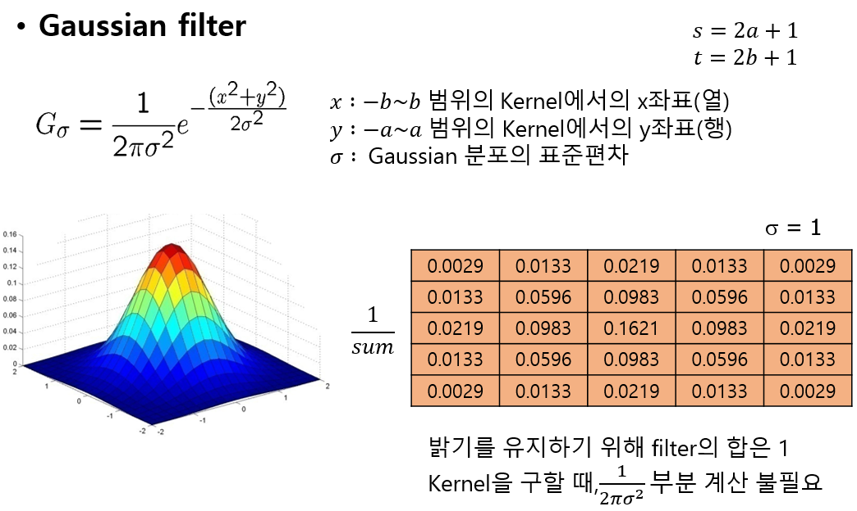
Solution
DownSampling (with Gaussian filter)
The kernel size depends on the difference in size between the source image and the target image
Kernel size = (src img width / trg img width) (if kernel size is even, +1)
Notes:
At this point, the Gaussian kernel size is assigned depending on the ratio of the source image and target image.
If Gaussian sigma is big or Kernel is so big, target image much more smooth than original image
In code, the width value is usually higher than the height value, denote kernel size as (like that).
Since kernel size is odd, if ratio is even, plus one in there

Slide 7
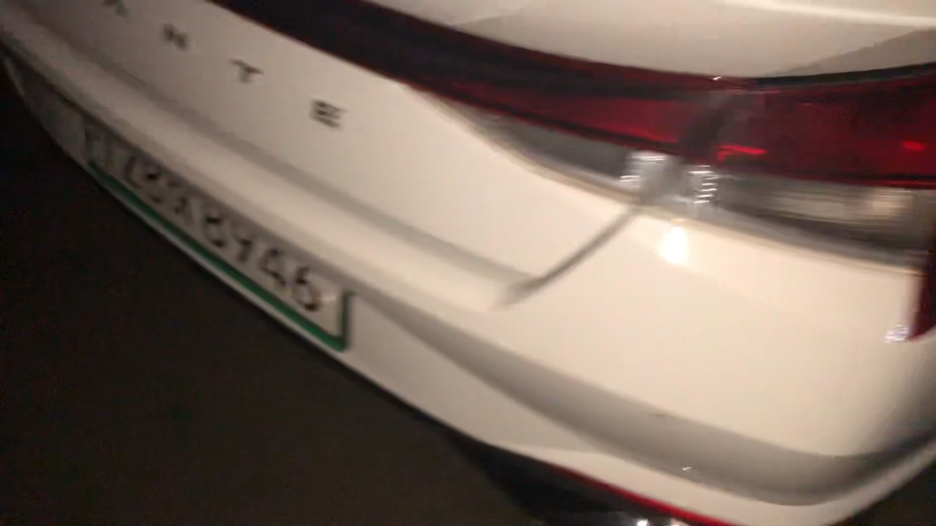
Solution
Flow Work
Get videos using OpenMP
Downsample videos ( Guassian + Spatial Aliasing)
Merge all videos
Notes:
The entire processing algorithm of the project. It consists of three parts.
First, call up the next frame in each video.
Second, Downsampling image to local size. (There are two task, Gaussian Blur and Spatial Aliasing)
Third, Merge all local image to one result image

Slide 8
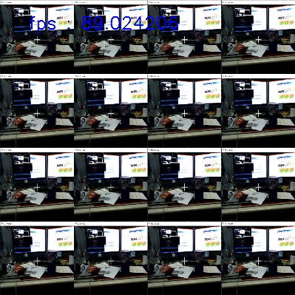
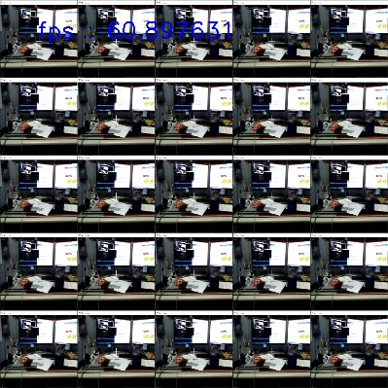
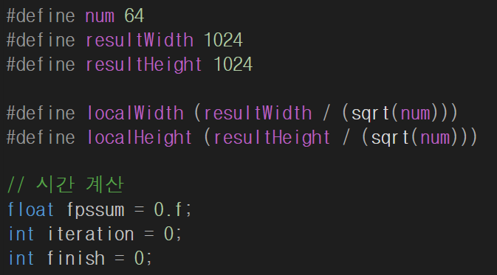
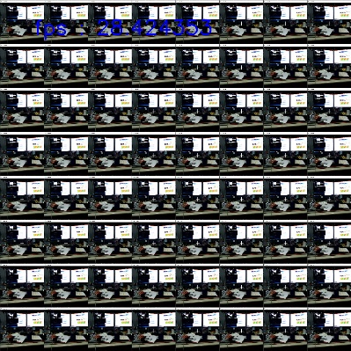
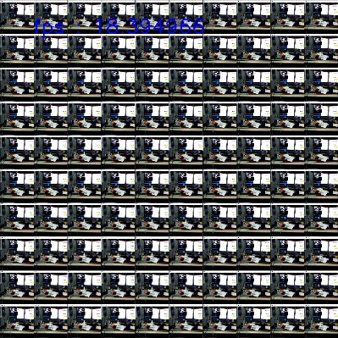
Solution
Main Code
Select the number of mosaic videos to the “num”
If video frame is empty, initialize “finish” and terminate mosaic
num = 16
num = 25
num = 64
num = 100
Notes:
Now, I will explain my code. I set the number of images and result size to be changed. Num is the number of images. It can output multiple Images, as shown on the right.
Local width, height means size of target image

Slide 9
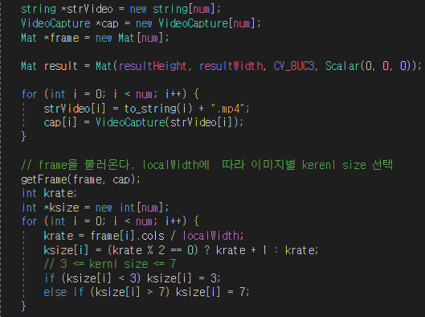
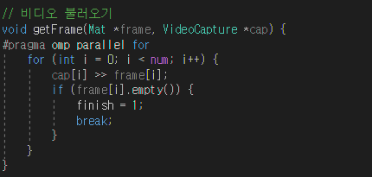
Solution
Main Code
Save frames for all captures in Mat form via “getFrame” function
3 <= kernel size <= 7 (kernel size = image width / local width)
Notes:
Each frame is called through the “getFrame” function, which uses OpenMP as shown.
Get frame and if there is no image either, change the finish value that end process.
And set the appropriate kernel size according to the frame size.

Slide 10
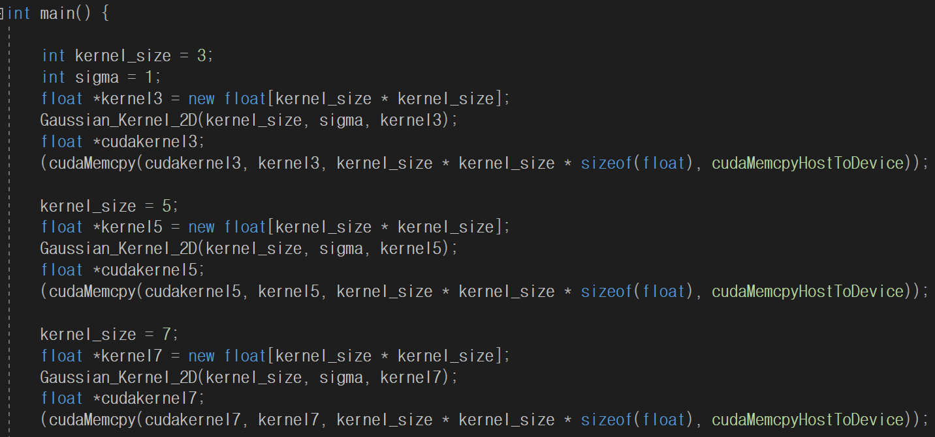
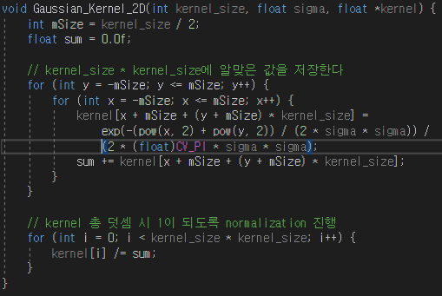
Solution
Main Code
Set kernel sizes to 3, 5, and 7
2D Gaussian Kernel Function
Notes:
Declare Gaussian Kernel of 3, 5, and 7. It is also stored in the GPU’s memory in advance.

Slide 11
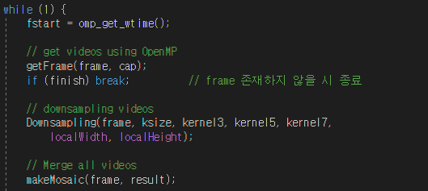

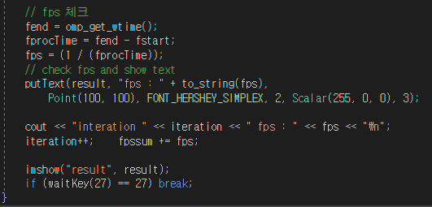
Solution
Main Processing part
Get videos using OpenMP
Downsample videos
Merge all videos
Notes:
The entire processing algorithm of the project. It consists of three parts.
First, call up the next frame in each video.
Second, Downsampling image to local size.
Third, Merge all local image to one result image

Slide 12
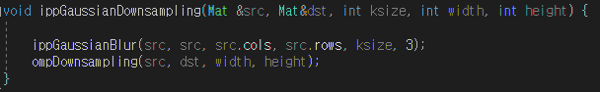
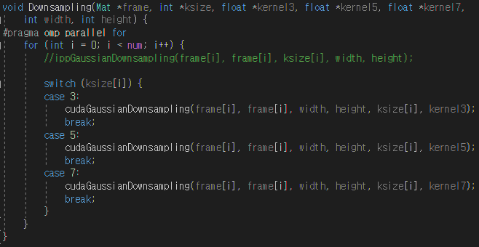
Solution
Downsampling using OpenMP
Downsampling part depending on each kernel size
Gaussian + Spatial Aliasing
Notes:
This is downsampling part. It devided into two parts : Gaussian Bluring / Spatial Aliasing
Gaussian Blur runs as a CPU with IPP Gaussian Blur or as GPU with CUDA coding. And depending on the ratio of image size, kernel size is changed.
Spatial Aliasing reduces the size of Gaussian Blur image.

Slide 13
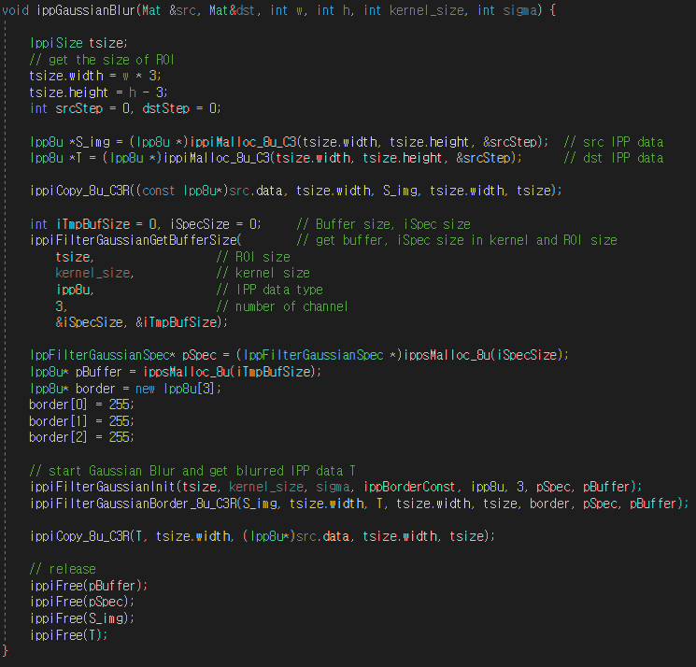
Solution
Downsampling IPP
ippiMalloc_8u_C3
Release ipp memory
Roi size
Width : w * 3
Notes:
This is CPU coding IPP Gaussian blur part. Unlike gray scale process, source step size has a value of w multiply 3.

Slide 14
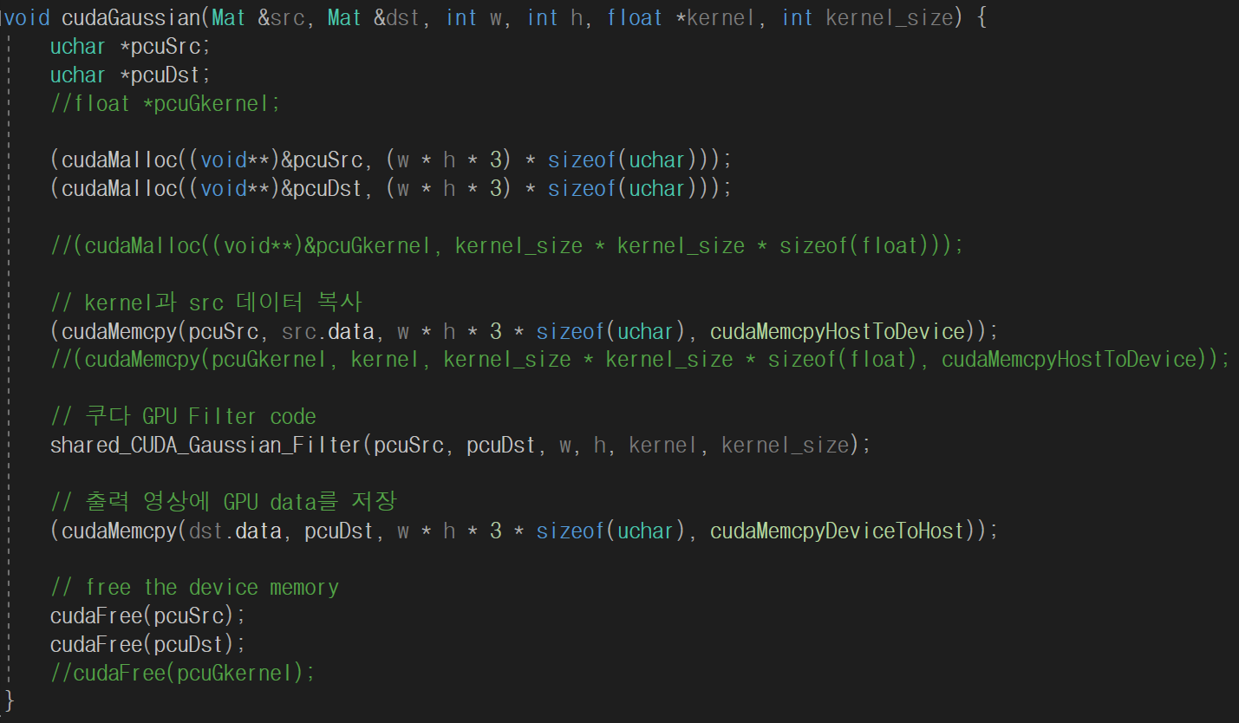
Solution
Downsampling CUDA - Host
Without “cudaMalloc” size specification, performance has improved
Use “uchar” as datatype
Notes:
This is CUDA host code. The kernel is declared in advance by the main function. Therefore, I only consider source and target images.
Datatype is “uchar”, I will explain in next slide how to calculate that with float kernel.

Slide 15
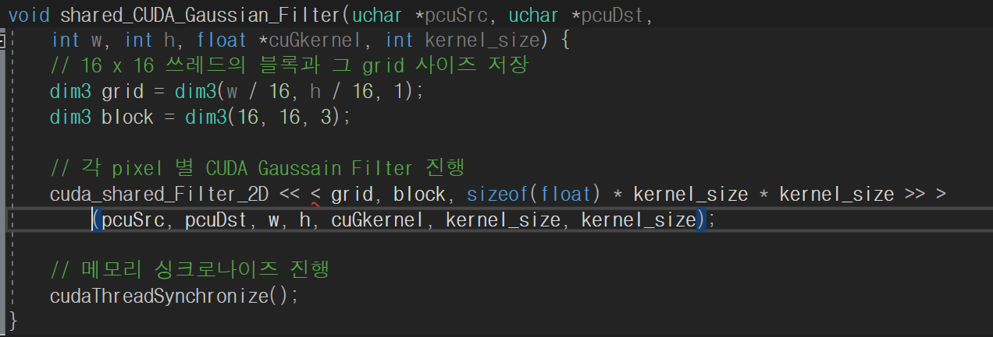
Solution
Downsampling CUDA - Host
Using 3D Thread for color calculation
Block Size : 16 x 16 x 3
Grid Size : (w/16) x (h/16) x 1
Notes:
I used 3D thread to calculate color image.

Slide 16
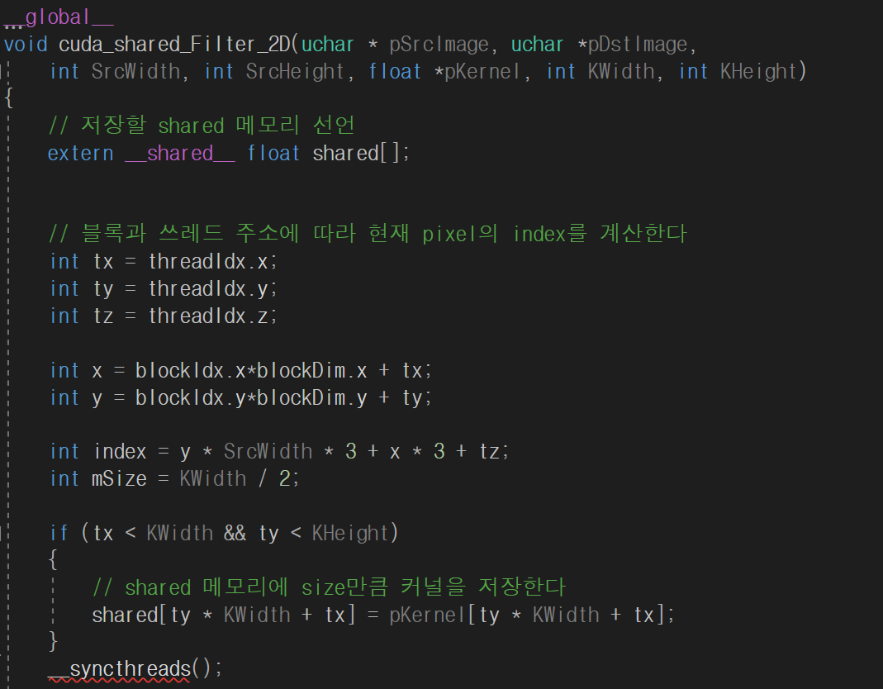
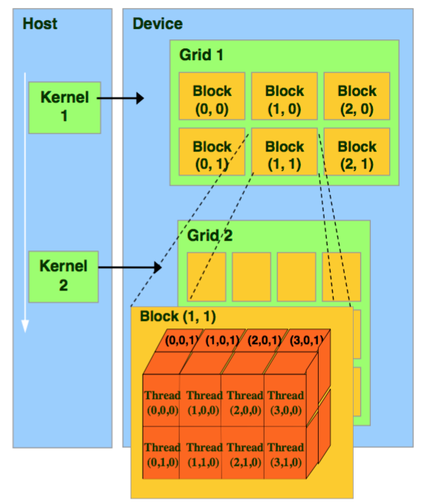
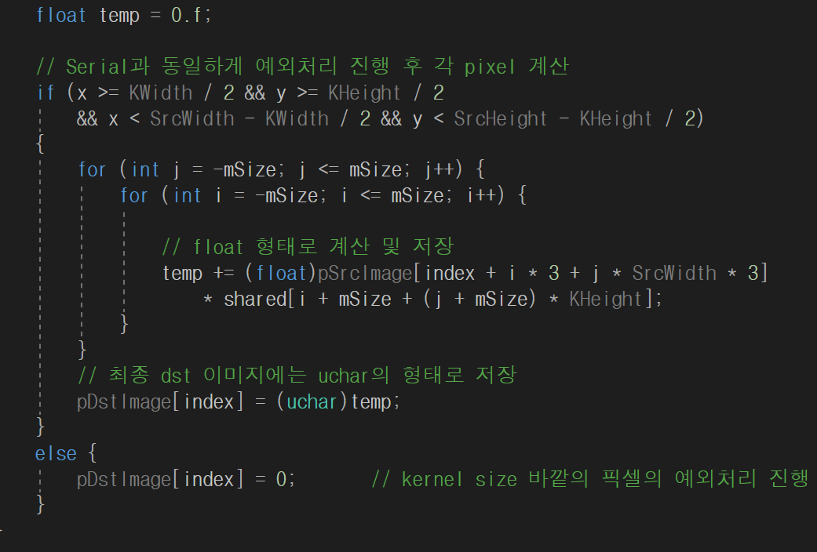
Solution
Downsampling CUDA - Device
Using 3D threads index
Notes:
I used shared memory.
Depending on threads, shared memory save guassian kernel.
Multiplying the kernel values by the appropriate index depending on the color image.
But at this time, the boundary problem was not solved.

Slide 17
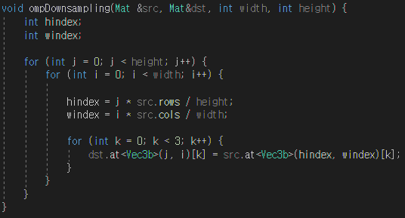
Solution
Downsampling using OpenMP
Spatial Aliasing
Target and source images have a constant proportion ( src width : trg width)
Target index = Source index X (src width / trg width)
Notes:
This is spatial aliasing part. Select points in Guassain result through the ratio of source size to target size. This was implemented in OpenMP, but later GPU parallel processing is possible.

Slide 18
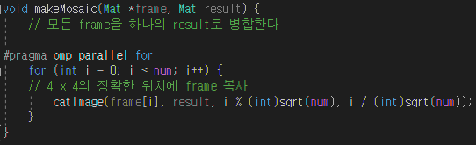
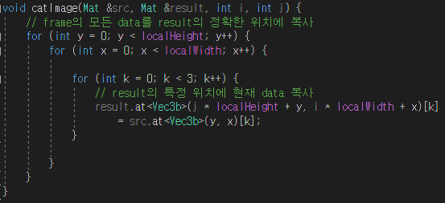
Solution
Make Mosaic Result using OpenMP
Merge all frames into one result image
Notes:
The last part of the algorithm is Merge part. It stores the local images in the appropriate location in result image. And is implemented as OpenMP.

Slide 19
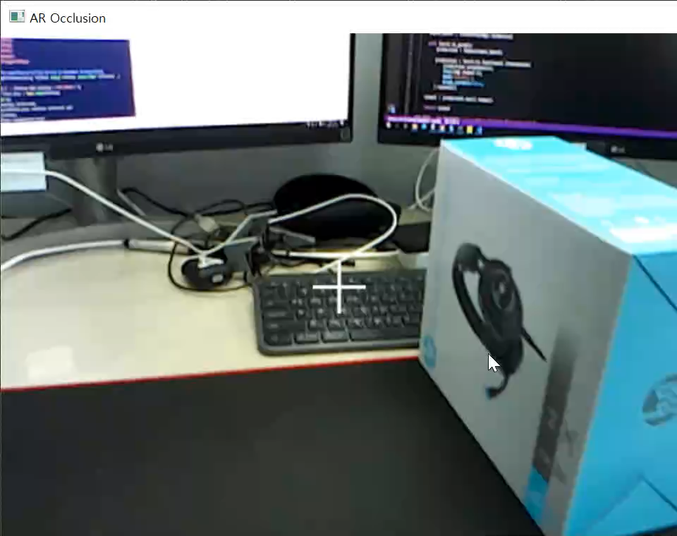
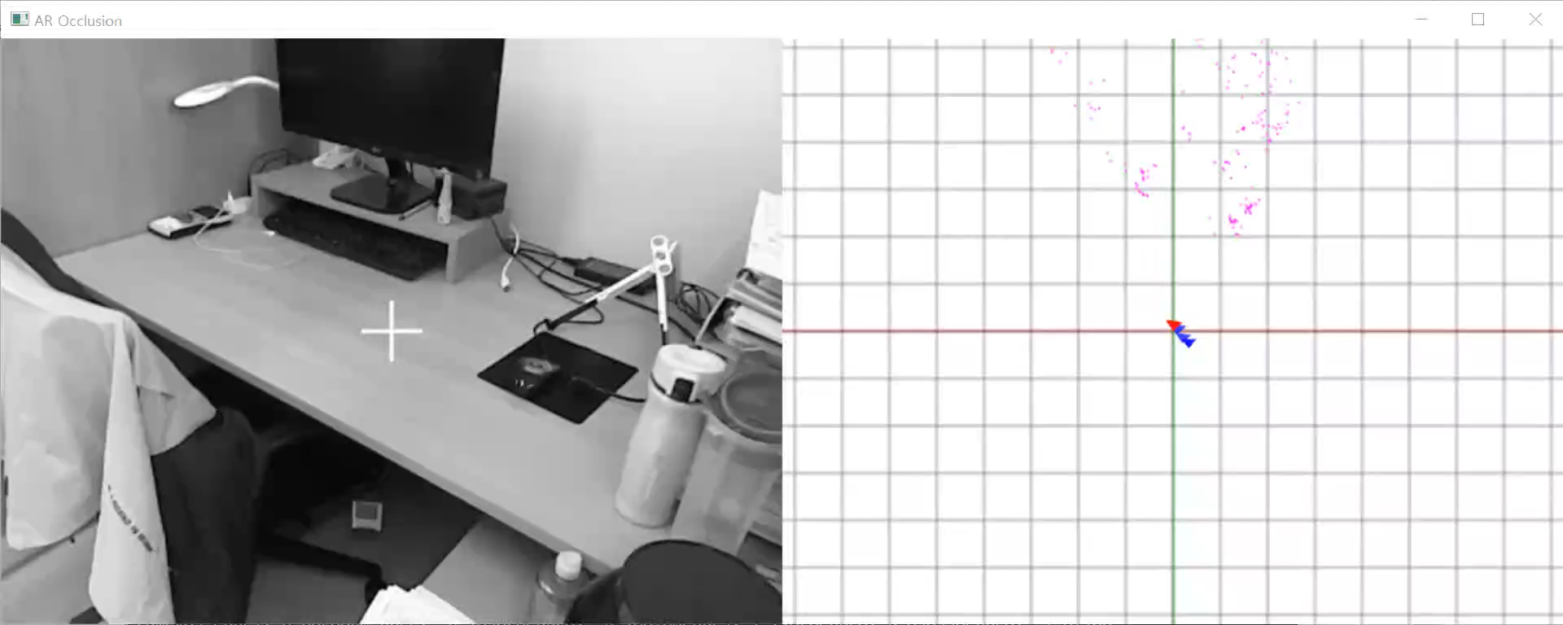
Experiments Results
Mosaic – Input Videos
GPU : NVIDIA GeForce RTX 2080 Ti
CPU : Intel(R) Core(TM) i9 – 9900KF CPU 3.60GHz
1280 x 720
640 x 480
1920 x 768
Notes:
Input videos with different sizes. In addition to basic images such as VGA, images with unique sizes as below are entered.

Slide 20
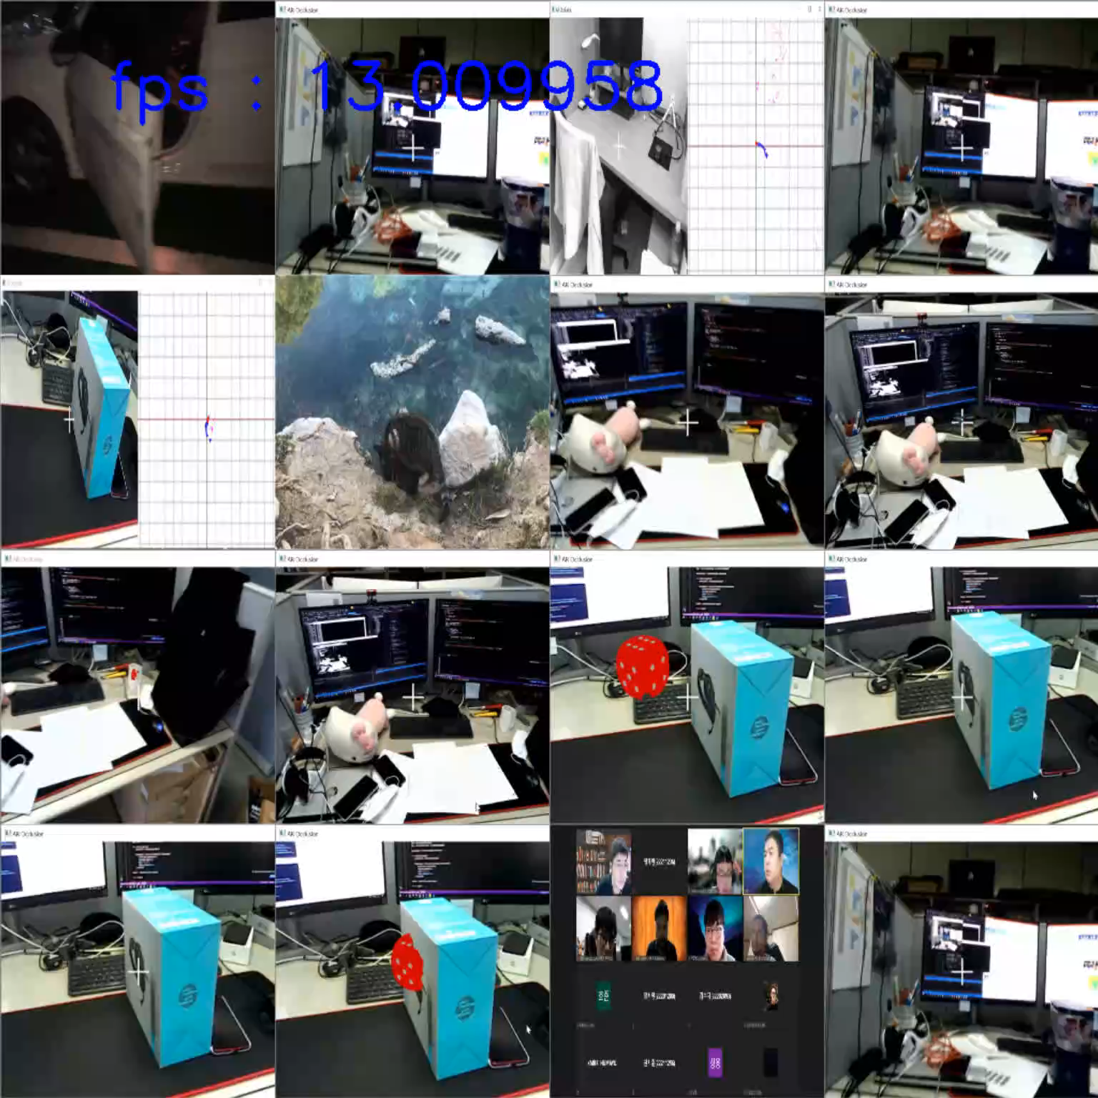
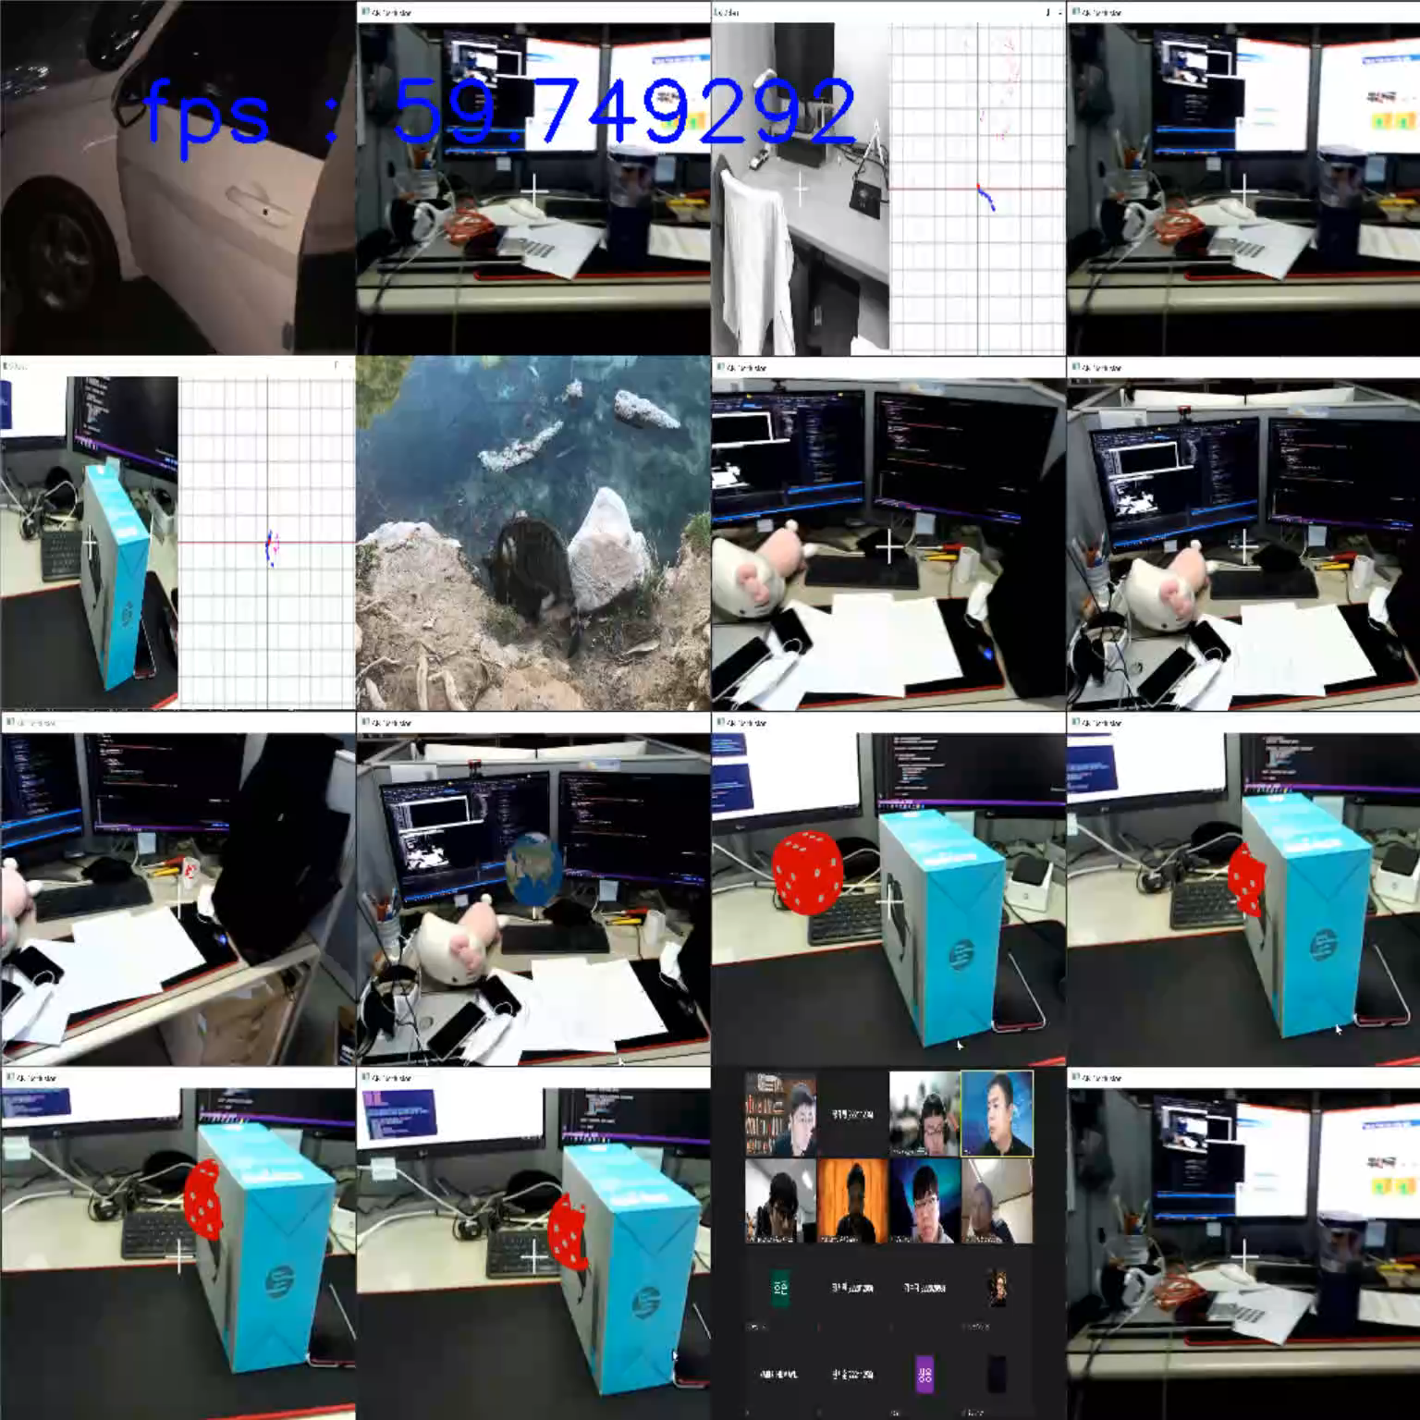
Experiments Results
Mosaic – 16 Image
CPU
GPU
Notes:
This is a result of a size 16 CPU and GPU.

Slide 21
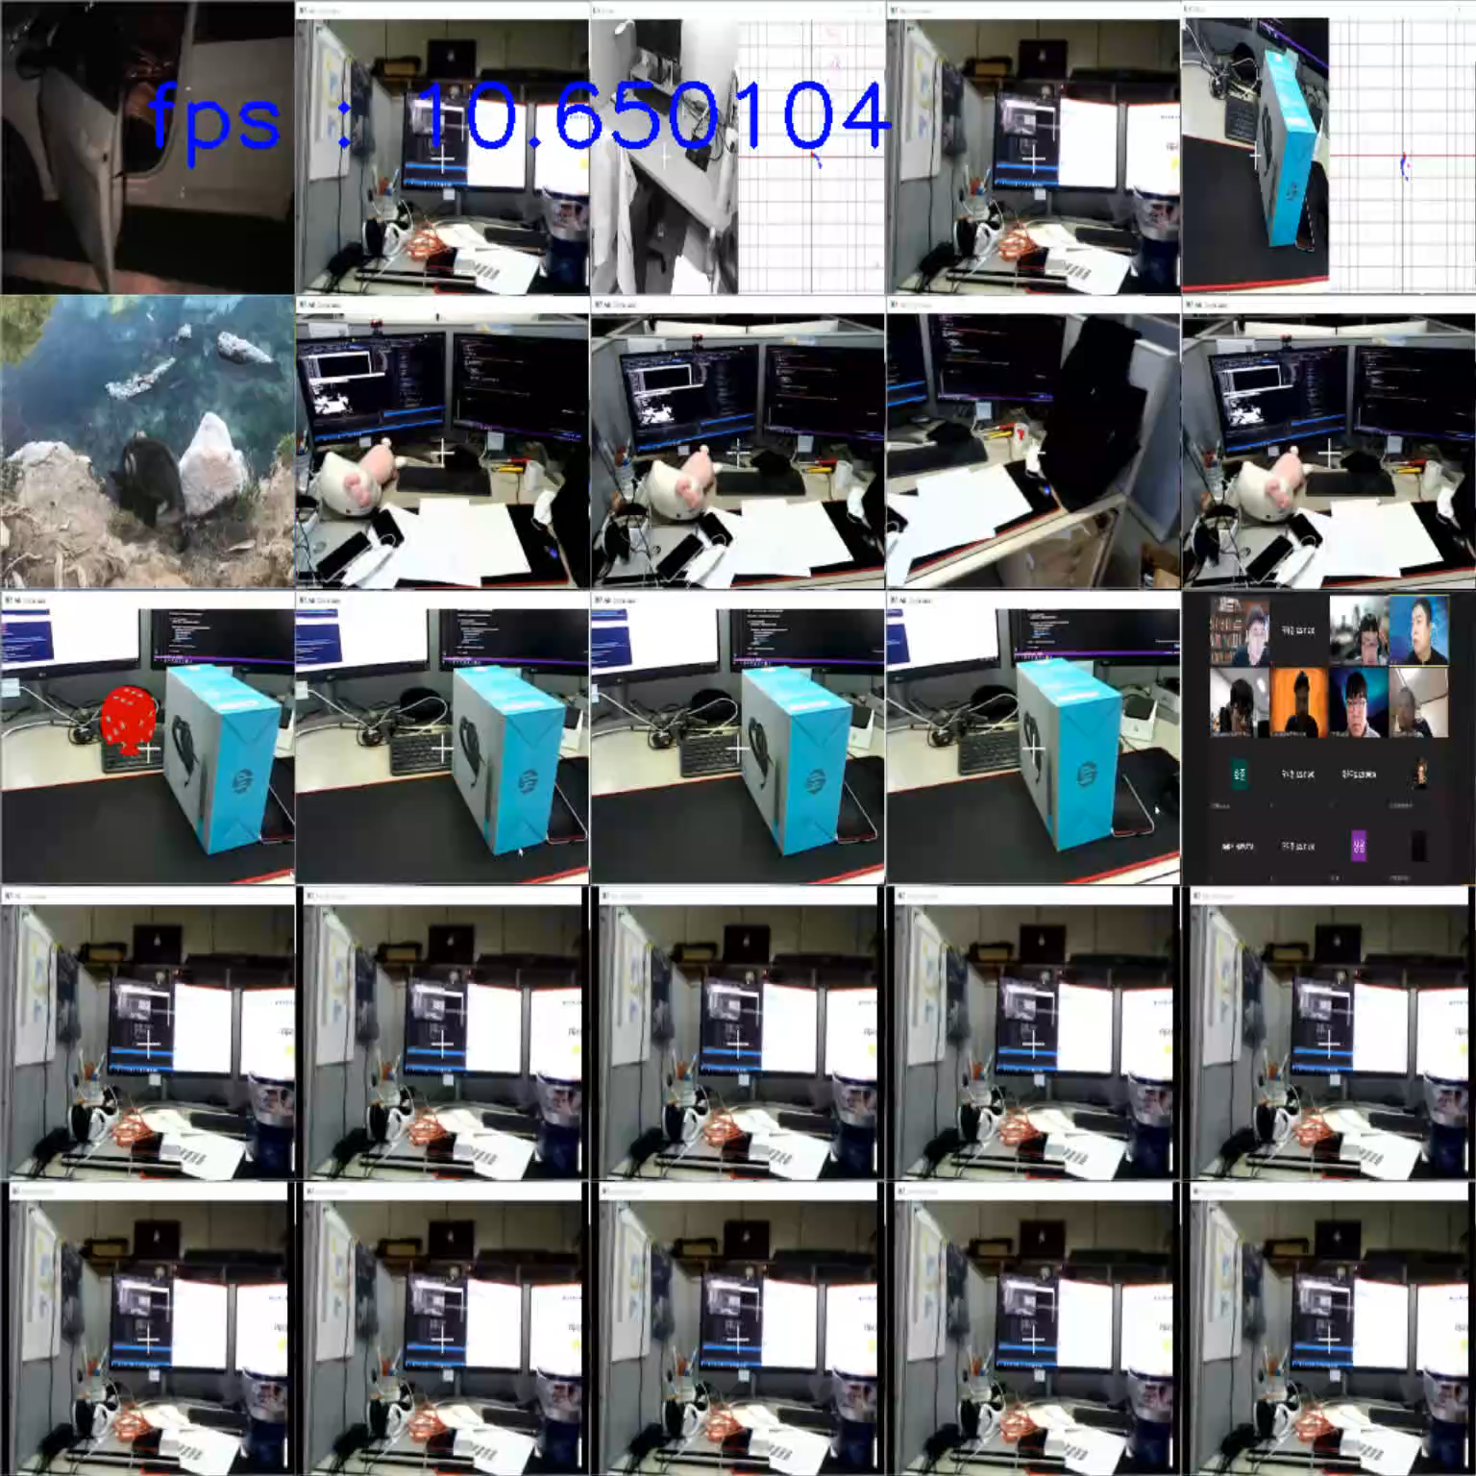
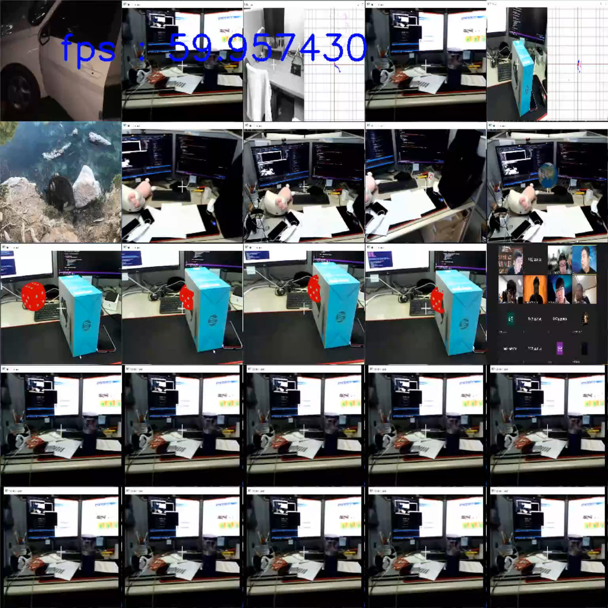
Experiments Results
Mosaic – 25 Image
CPU
GPU
Notes:
This is a result of a size 25 CPU and GPU.

Slide 22
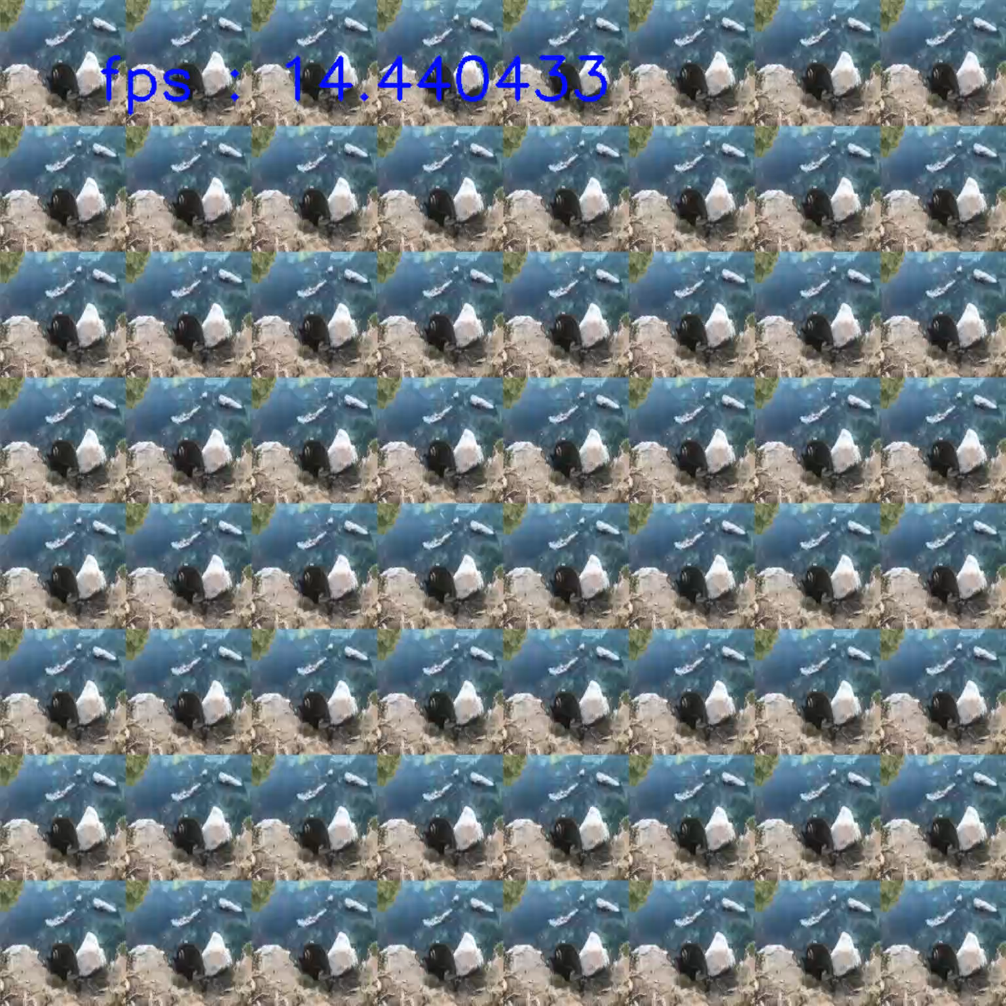
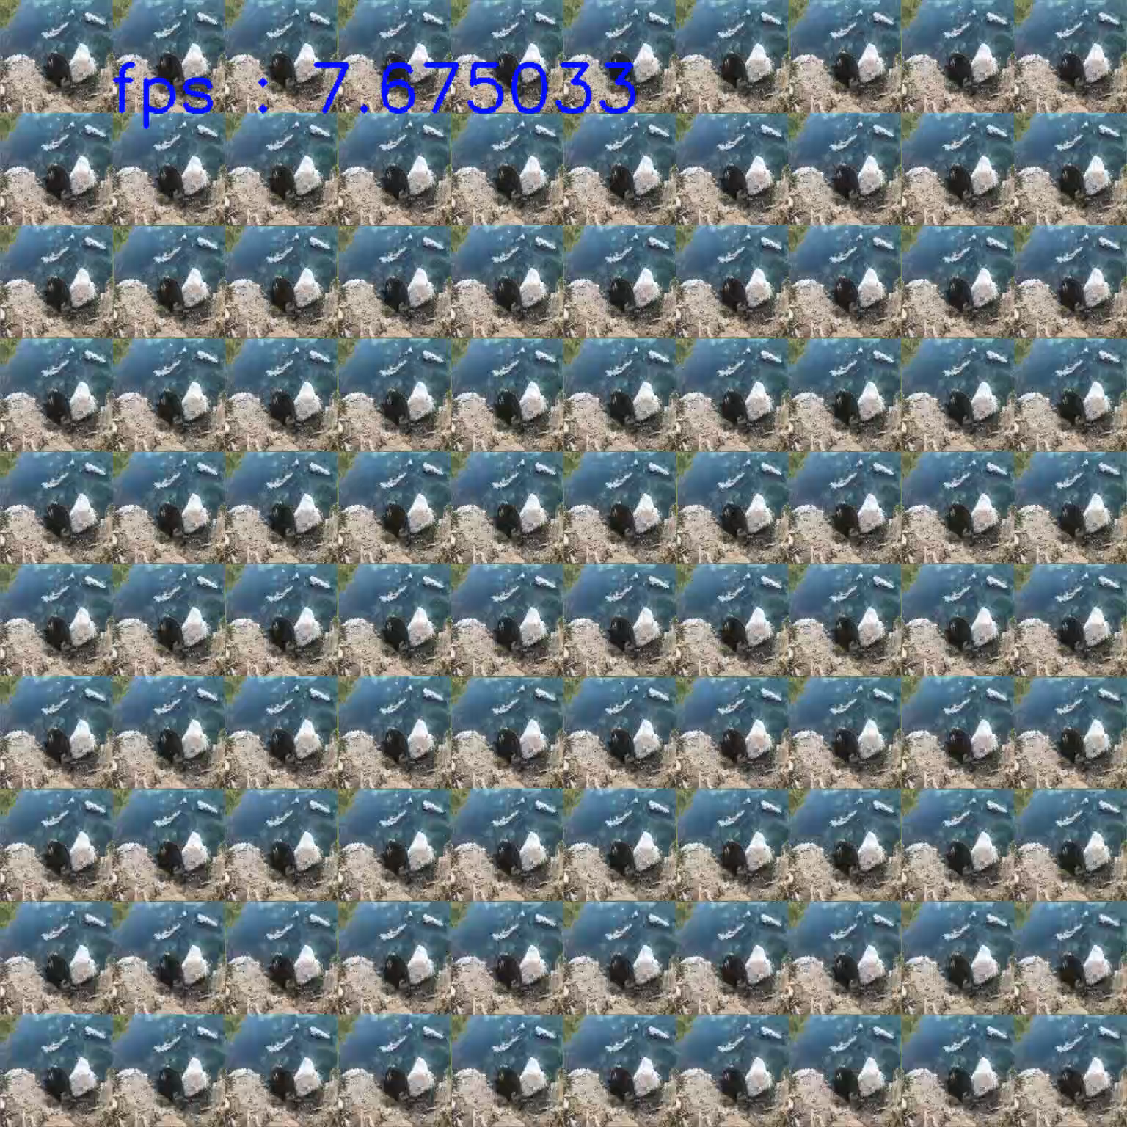
Experiments Results
Mosaic Using GPU – 64, 100 Image
num = 64
num = 100
Notes:
Images such as 64 and 100 can also be expressed with the code.

Slide 23
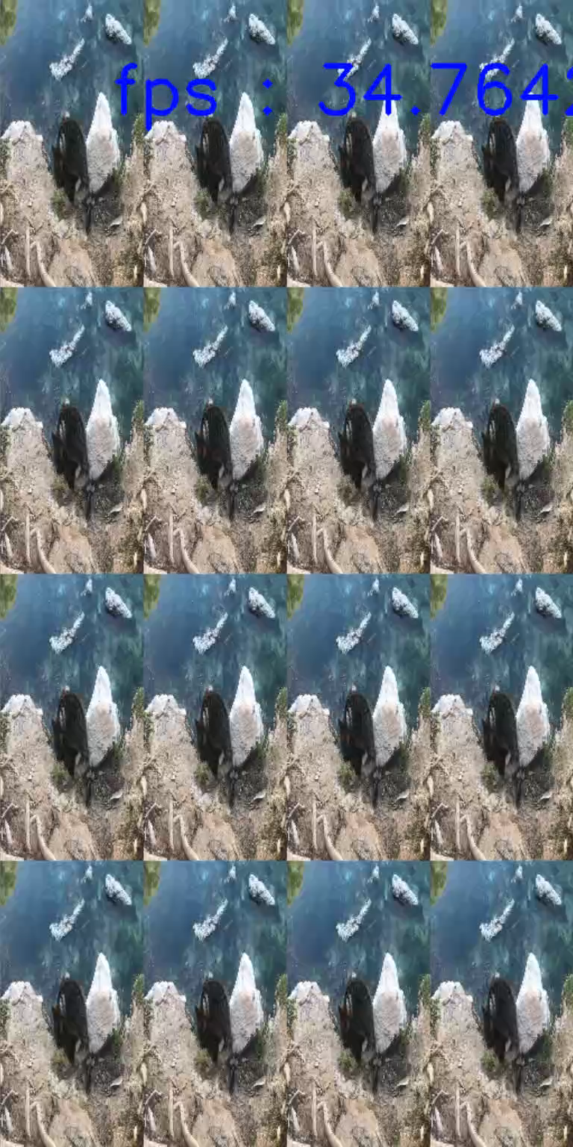
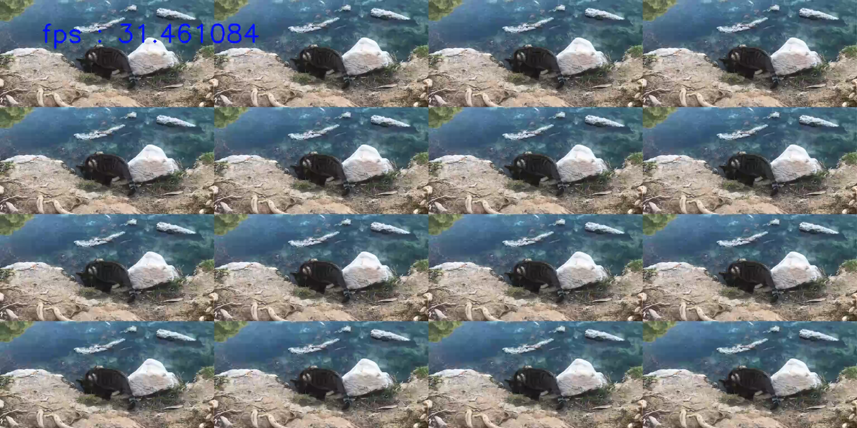
Experiments Results
Mosaic Using GPU – Other Size
2048 x 1024
1024 x 512
Notes:
The size of the resulting image can also be changed.

Slide 24
Analysis
Mosaic Analysis
All Image (pixel) | Image num | IPP Without OMP (fps) | IPP With OMP (fps) | CUDA Without OMP (fps) | CUDA With OMP (fps)
1280 x 720 | 16 | 5.187 | 19.082 | 26.995 | 50.303
 | 25 | 2.283 | 9.541 | 19.646 | 34.361
640 x 480 | 16 | 16.582 | 61.841 | 34.981 | 108.227
 | 25 | 11.435 | 40.913 | 27.027 | 75.208
Notes:
Measure the fps of downsampling by putting only a certain size as input value.
Overall, GPU-based coding was 2.5 times faster than CPU-based coding. It also recorded twice the speed when using OpenMP within the code.

Slide 25
Conclusion
Parallel Image Processing
When using parallel image processing techniques, speed improvements are identified.
In particular, it recorded up to 5x performance improvement in experiment result when using CUDA.
By attempting to use threads in 3D in CUDA, a broader perspective on parallel processing could be obtained.
However, CUDA coding does not solve the boundary problem. So It is not perfect code.
Furthermore, since OpenMP processing can be optimized and changed to CUDA, further performance improvements are expected.
Notes:
up to 5x performance improvement in experiment result when using CUDA
CUDA coding does not solve the boundary problem. Therefore, It is not perfect code
I didn't create a Gaussian code based on SSE. It was too difficult to implement the idea in color image.
It was good to review many techniques of parallel image processing through this task.

